Slide 1
Inside Lives Longitudinal qualitative community of citizens and small business owners
Bulletin 4 (26/05/2020)
Sustainability and a changing context for habit formation
Kantar’s Public Division UK

Slide 2
Inside Lives is a longitudinal qualitative study created by Kantar to offer our clients rapid access to a rich qualitative understanding of public experiences, feelings and beliefs during the COVID-19 crisis.
In this bulletin we look at changing consumer habits and views around sustainability
Please get in touch to discuss any of the issues covered in this bulletin in greater depth
2

Slide 3
Community members take part in three weekly tasks
Temperature check tracking and diary activities
Thematic community activities
Topical message board discussion
Findings in this document are drawn primarily from tasks conducted in w/c 18th May

Slide 4
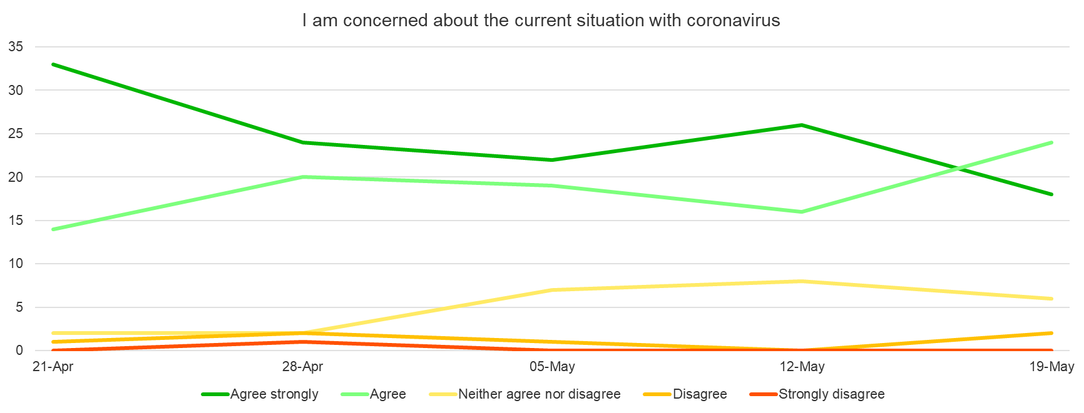
Strength of concern about the current situation with coronavirus has subsided over the course of the community
A slight spike in concern following the switch to a ‘Stay Alert’ message was followed by a more pronounced reduction in the following week with acclimatisation to the relaxation in lockdown measures
Switch to ‘Stay Alert’ message
4

Slide 5
Air pollution and car travel dominate concerns about ‘sustainability’
Lockdown has highlighted to many the benefits of reduced car travel, but most see this as a temporary shift without wider systemic change to support individual behaviours
The environment is not a top-of-mind priority for most participants, ranked behind the economy, health, Britain leaving the UE, education and crime
However, lockdown has made some issues, such as air pollution, more salient and foregrounded human impacts
Widespread adoption of more sustainable behaviours is motivated primarily by other factors such as restrictions on travel (walking) or concerns over budgeting (reduction in food waste)
Car travel dominates conversations about individual impacts - and most believe usage will return to pre-lockdown levels when life returns to ‘normal’
Citizens are looking to government and businesses to lead on environmental issues via financial incentives and support for flexible working policies (businesses are in turn looking to government!)
Please contact us for full video content
04:15
Click video to play
5

Slide 6
‘Stickiness’ of new behaviours will depend on wider contextual factors
New habits will stick when they ‘make sense’ to people within their wider context – looking ahead concerns about physical safety and worries about ongoing economic impacts are likely to push behaviours both in more and less sustainable directions
“
+
Continued focus on home life (‘nesting’) and reductions in non-essential travel, including flying
Safety / hygiene concerns
I will definitely be driving more once lockdown ends. My daughter is due to go to secondary school in September and her new school is a 45-min bus ride away. I am nervous about her getting in public transport for that long with the risk of transmission so me and my wife will probably end up driving her where possible!
Male, North
-
Preference for personal over public modes of transport
+
Continued focus on ‘thrifty’ behaviours (e.g. meal planning and reduced food waste)
Economic uncertainty
Although I have really liked supporting local businesses and getting food deliveries from them throughout this time, I don’t think we will use them with the same frequency sadly because it works out as an expensive option and I’m just not sure I can justify that
Female, South
-
Trading down to more basic and less sustainable products
6

Slide 7
Discussion focuses on human impacts on environment
There is universal positivity about environmental shifts during lockdown, which have highlighted human impacts, but most are fatalistic about the sustainability of these without policies to drive systemic change
All very positive a lot less cars on the road. With so many people working from home…I would like to work from at least 1 or 2 times a week after lockdown but it would be up to the department, I will need to wait to see what they allow
Female, 60+, London
More positive than negative- fewer cars, fewer people. Just shows you people are a menace on the environment- littering, polluting. More effort needs in providing people with clear "road maps" for real green living which are possible.
Male, SME owner, South
It appears to be making a massive difference to the natural world, which can only be a good thing. Hopefully the good habits we have picked up and the joy we get from this will stay with some of us, although I have my doubts. Now is the time to pedestrianise town centres and keep traffic at bay.
Male, family, South-west
7

Slide 8
Upcoming topics
New activities launch every Friday and run for a week
Bulletin 5: Financial impacts and experience of government support schemes
Bulletin 6: Social relationships in lockdown and beyond
Planned coverage for future weeks includes…
The return to schooling with social distancing
Attitudes and expectations for flexible working post-pandemic
Please get in touch to discuss any topics or issues that you would like to see explored with the community in future weeks
8

Slide 9
Inside Lives offers rapid access to a rich qualitative understanding of public experiences, feelings and beliefs during the Covid-19 crisis
Measures taken to prevent the spread of Covid-19 present new challenges for policy makers needing to respond rapidly to changing conditions.
Inside Lives offers a bridge between policy-makers and those they represent at a time when face-to-face research routes have become impossible.
Inside Lives is an ongoing online community of 50 individuals to provide longitudinal qualitative insight into responses to the pandemic.
Coverage includes a diverse range of life stages and relevant circumstances – including those who have lost work, key workers in health & education and those living alone – as well as 10 SME owners drawn from a variety of sectors.
It offers fast-turnaround access to experiences, behaviours, feelings and beliefs of people living with, and looking beyond, Covid-19.
We collect insight via individual tasks to illuminate personal stories and moderated activities to deepen understanding of issues such as home-schooling, flexible working, travel, food practices, and attitudes to sustainability.
We engage participants via regular tracking measures and video diaries, alongside weekly bespoke community activities and discussions.
Participants log on twice each week for at least 30 minutes to engage with tasks, moderator probes, and other community members. Reporting is powered by our expert qualitative analysis, and brought to life via video and other multimedia material.
Alongside these free weekly bulletins, we also offer curated access to the panel on a weekly basis and bespoke analysis for your topic of interest.
Curation of the panel for one week, with custom-designed activities and outputs delivered in as little as 2-3 weeks, is available from only £8,275
In-depth analysis of non-curated weeks is available from £2,800 (excl. VAT)
Email our team to find out more

Slide 10
About Kantar
Kantar is the world’s leading evidence based insights and consulting company. We have a complete, unique and rounded understanding of how people think, feel and act; globally and locally in over 90 markets. By combining the deep expertise of our people, our data resources and benchmarks, our innovative analytics and technology, we help our clients understand people and inspire growth.
Kantar’s Public Division is the global leader in public policy research, evaluation and consultancy.
@Kantar
www.kantar.com
Nick Roberts
nick.roberts@kantar.com
07521 605 793
Amy Busby
amy.busby@kantar.com
020 7656 5949
Kantar’s Public Division UK | 4 Millbank, Westminster, London, SW1P 3JA | www.kantar.com

