Slide 1
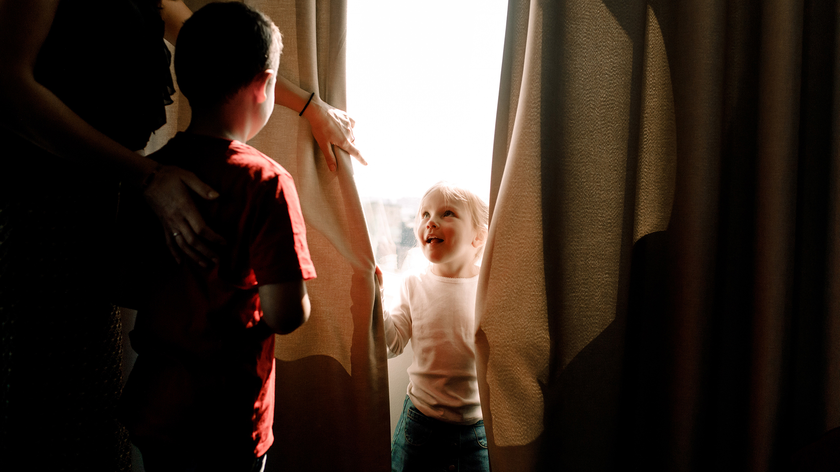
Inside Lives Longitudinal qualitative community of citizens and small business owners
Bulletin 9 (05/10/2020)
Public priorities for the future
& Britain’s ‘new normal’
Kantar’s Public Division UK

Slide 2
Inside Lives is a longitudinal qualitative study created by Kantar to offer our clients rapid access to a rich qualitative understanding of public experiences, feelings and beliefs during the COVID-19 crisis.
In this bulletin we look at people’s priorities for the future and the type of ‘New Normal’ they hope for
Please get in touch to discuss any of the issues covered in this bulletin in greater depth
2

Slide 3
Community members took part in three weekly tasks
Temperature check tracking and diary activities
Thematic community activities
Topical message board discussion

Slide 4
Following 8 weeks of activities, participants returned for a final week
Sustainability
Economic support measures
Home-schooling and education
Flexible working
Past topics included
Reflections on how life has changed
Personal priorities for the future
Priorities for the country
Government measures and messaging
Final week topics included
Please get in touch for information on any past or final week topics explored
4

Slide 5
Lockdown seeded new behaviours and shifted personal priorities
During lockdown many experienced a slower pace of life and developed new, healthier routines that triggered a change in personal priorities
Throughout Inside Lives we have observed the extent Covid-19 has shaken up the status quo and caused disruption to societal norms and ways of living.
Whilst this disruption was initially stressful, participants quickly adapted to their new environment and started to develop new routines - viewing some of the changes to their lives as positive.
Many welcomed the opportunity to experience a slower pace of life with lockdown forcing them to strip back their hectic lifestyles and go back to basics.
It gave people time to reflect on their values and what is most important to them, with Covid-19 appearing to be a catalyst for changing people’s priorities.
The biggest changes in mindset have been towards working arrangements, personal and family health and approaches to spending money, with Inside Lives revealing an overall shift away from fast-paced, stressful, materialistic living - moving instead towards a wellbeing and family-first mentality.
Cooking healthy meals
Increased sleep
Exercising more
Self reflection
More time in nature
Family time
Nesting
New hobbies
Local community support
Positive
Outcomes
5

Slide 6
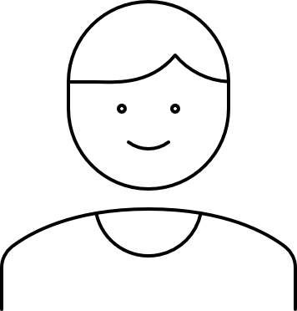
The community discussed their hopes for a ‘new normal’
Rather than going back to the ‘old normal’, the pandemic was seen as an opportunity to rebuild a better Britain by retaining the positive outcomes of Covid-19
I'm hoping that life will not return to the old normal. This virus and lockdown has shown us we can do things differently. The way we go about our lives can change and change for the better.
Male, Family, London
I certainly hope we take new opportunities on board and look more to a newly designed future. Take the best from the old and embrace the new.
Female, Family, North
I think there are plenty of opportunities to improve life. The nightmare of the rush hours in every city and the grind of the daily commute could be mitigated by the majority working at home, thus saving time, money and the environment, which, remember, improved during lockdown in a significant way.
Female, 60+, South
6

Slide 7
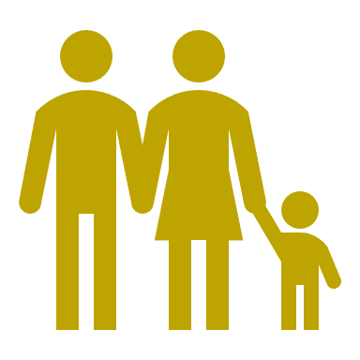
People wanted their ‘new normal’ to be characterised by better wellbeing
“I'm certainly enjoying the local area more and have discovered some great parks and woodlands.”
Save•View Response
“Just appreciating nature more.” – female, SME
When discussing the changes to their life during lockdown, people wanted to maintain behaviours linked to better wellbeing
The new habit I've picked up is going for more walks with the family… its now a priority that I spend time with them and I will go out my way to plan such time. Male, Family, London
Whilst there are aspects of their life they would like to return to normal, such as the ability to socialise freely with friends and family, many aspired to retain positives outcomes of Covid-19.
Four key themes emerged when discussing changes to keep, with these all being linked to and driven by a desire for greater wellbeing and a better quality of life:
More family time
A healthier lifestyle
More time in nature
Closer community connections
I will 1000000% keep trying to work on my health and fitness - that is something that cannot be taken for granted anymore. Female, Pre-family, North
I’ve enjoyed nature not getting caught up in material things. Female, Family, South West
02:55
I would love to have as much time as l have now to talk to people around me. Male, Pre-family, Midlands
7

Slide 8
More family time
Many living with family members appreciated the opportunity to spend quality time together, and placed high importance on trying to maintain a better balance between work and family life
“
During lockdown many valued having more time with family, and used this to do shared activities that were felt to signify ‘quality time’ together and enhanced their sense of wellbeing, such as cooking, playing games and making things.
Parents enjoyed being part of the moments they might ordinarily miss e.g. family meals or bedtime, and some felt the additional time together had brought them closer to their spouse.
The lockdown and remote working were seen as primary drivers of being able to spend more time with family, with key workers and those unable to work from home not having this same opportunity.
Among those who did, a prominent trend was seen, with both men and women reflecting on their previous work-family ratio and wanting a future where they can maintain a better balance between the two.
We have learnt to work more as a team in our family unit and it’s been great to spend time together... I think I wouldn’t want to work full time in an office anymore. I would like to keep the home life balance.
Female, Family, North
I have also learned to cook a bit more, and generally been able to spend more quality time with my family… I appreciate that so much more now.
Male, SME
I think my husband is [more] supportive. He shares household duties with me. He’s never done that before.
Female, Family, Midlands
8
Notes:
Notes on home-schooling
Parents of school aged children highlighted the complexities of home-schooling but reflected on how it had allowed them to assess their child’s academic strengths and weaknesses in way they could not before.
Notes on spousal relationships
In some cases, participants noted feeling less close to their partner, flagging that spending more time together had highlighted issues within their relationship.

Slide 9
A healthier lifestyle
Lockdown gave people the time and incentive to develop behaviours that improved their physical and mental wellbeing, with many wanting to retain a healthier lifestyle going forwards
“
Findings suggest the pandemic triggered people to reflect on the importance of maintaining their mental and physical health, with many using lockdown to do more exercise, eat healthily, get more sleep, self-reflect and re-prioritise goals.
Drivers of a healthier lifestyle included the health threat of Covid-19, improving their wellbeing and regaining a sense of control and having more time due to remote working and restrictions on other activities.
Participants wanted to continue these behaviours but felt it would be difficult if they returned to a pre-COVID-19 pace of life where convenience and time-saving options (e.g. car use, takeaway food) take priority.
Additionally, with the negative consequences of Covid-19 expected to be a long-term challenge, such as unemployment and isolation, some envisaged the availability of mental health support would become increasingly important.
Generally I have noticed that mentally I am doing a lot better which would likely not have happened if I was still back in the 'rat race' before the lockdown. I will 1000000% keep trying to work on my health and fitness - that is something that cannot be taken for granted anymore. You need to do what you can to look after yourself!
Female, Pre-family, North
I would like to keep cooking from scratch more as it's cheaper and healthy and I'd like to keep being organised as it gives me a sense of achievement. I think I will only stick for a little bit as they both rely on me having more time to do things and if I get too busy I doubt I'd want to cook from scratch every night.
Female, Pre-family, South West
9

Slide 10
More time in nature
Restrictions during lockdown and the positive impact on wellbeing have driven more appreciation for spending time in nature, subsequently increasing the salience of environmental issues
“
During Inside Lives we observed an increase in people’s appreciation for nature and spending time outdoors, with this being a change in their lives they wished to maintain going forwards.
This aligns with findings from Natural England’s People and Nature survey, where around 4 in 10 adults* reported spending more time in nature than before the pandemic, with health and wellbeing being the main drivers.
Less noise and air pollution from a reduction in car and aeroplane travel, was also felt to enhance the enjoyment of spending time in green spaces.
Greater appreciation for nature appears to have contributed to an increase in consideration towards sustainability issues, with participants voicing their hope for the UK to build on the positive environmental outcomes of Covid-19 and 9 in 10* reporting that protection of the environment is important to them.
[I would like to keep] enjoying nature and not getting caught up in material things. Enjoying the little things in life like being more mindful in the current moment as opposed to always in a rush to get everything done.
Female, Family, South
It'd be nice if we could maintain some of the nice things from the Covid situation, around looking after the environment better and being more aware of the impact.
Male, Family, London
04:05
*https://www.gov.uk/government/news/public-love-for-nature-during-covid-19-highlighted-by-new-survey
10

Slide 11
Closer community connections
Participants aspired to maintain the greater feeling of togetherness and local community support facilitated by the pandemic, although this sense of unity has fragmented since lockdown eased.
“
Participants valued feeling closer to their local community during lockdown, for example, by shopping at local retailers and talking to or helping neighbours.
Drivers of this positive outcome included the absence of seeing family and friends, a slower pace of life and a stronger sense of local and national solidarity stemming from their shared lockdown experience.
Whilst connecting with and helping others locally improved wellbeing, these behaviours were not seen as conducive with fast-paced, modern living.
Additionally, local unity was felt to reduce post-lockdown and government guidelines became unclear, with different interpretations causing some tension.
However, many wished to maintain or regain this sense of community and emphasised the importance of supporting local businesses recover financially.
I think this virus has brought together communities in a way not seen since the war. I hope this will continue on and people will look out for each other going forward.
Male, Family, South
I think people will value local businesses and shops far more since lockdown as many of these businesses reinvented themselves and did home deliveries etc., which just made the world of difference. I hope that people will continue to support them in the future.
Female, Family, South
04:05
11

Slide 12
Remote / flexi working was seen as central to maintain these behaviours
New ways of working facilitated better wellbeing whilst being linked to wider societal benefits, but people do not feel the ability to continue working flexibly is within their control
Many felt the ability to maintain behaviours linked to better wellbeing, rested on continuing to work remotely and / or flexibly.
This was driven by the view that these new ways of working provided the time and opportunity to more easily integrate non-work related activities into their lives, such as spending time outdoors and with family.
Participants therefore envisaged a future ‘normal’ where working from home, at least a few days a week, becomes the norm.
Less commuting was also felt to provide wider societal benefits with Covid-19 showing that what is good for people can be also good for business, the environment and society.
However, many doubted their ability to continue working from home in the long-term as this would depend on their employers’ policies.
Remote or flexible working
More me-time
Good for physical / mental health
More flexibility
Good for gender equality
Less or no
commuting
Money saved
Good for local community
More productive
Good for business
Less traffic
Good for the environment
Less ties to London / cities
Good for
levelling up
12

Slide 13
Participants also recognised the importance of economic recovery
The UK’s economic recovery continued to be a prominent concern and was seen as a key priority for the country, with a key question being how to rebuild the economy in a way that supports better wellbeing
Announcement: UK is “past the peak”
Announcement: reopening of non-essential shops
13

Slide 14
The government was felt to play a key role in facilitating a ‘new normal’
Many wanted the government to offer a vision for the future that fuels economic recovery whilst retaining the positive outcomes of Covid-19, with clearer and stronger leadership felt to be required
“
People felt government support was needed to maintain the positive outcomes and healthier behaviours stemming from Covid-19, particularly in relation to home-working, as they require structural changes and employer support.
They therefore wanted the government to seize the moment and see the pandemic as an opportunity to look forward (not back) by creating a vision and policies that facilitate both economic recovery and better wellbeing.
However, messages encouraging people to go back the office suggested to participants that the government will support a return to the status quo.
Moreover, with post-lockdown policies being viewed as confusing, inconsistent and reactive, many were sceptical the government would provide the longer-term, holistic vision and clarity they felt was needed to facilitate a new normal.
As a result, whilst they hoped for a new and improved ‘normal’, many were pessimistic and expected (or were already experiencing) a return to their old ways.
I would like to go back to a better normal where working from home is the new norm… commute only 2 days a week, work more flexibly, more family time will be given… I would love my life to be like that but it’s dependent sadly on the job situation [his employer].
Male, Family, London
At the end of the day, I don’t think many opportunities will be followed up... Nobody is brave enough to devise a completely new strategy for the country… instead, we will probably get what we always get – a succession of sticking plasters… If that cycle were to be broken, in 20 years… we could be like some of those countries we look at with envy, such as Denmark or New Zealand.
Female, 60+, South
14

Slide 15
An opportunity to marry public priorities with policy objectives?
Findings from Inside Lives suggest there is an opportunity to marry people’s personal priorities with longer-term government policy objectives, which may help to accelerate these agendas
Our findings suggest the public mood is currently in line with long term policy goals.
For example, by showing a positive impact on the environment can occur through changes that benefit individuals (e.g. home-working, cycling more), Covid-19 has increased the salience of environmental issues.
This indicates an opportunity to link people’s personal priorities to overarching government goals by creating bottom-up, people-led policies that are more likely to drive in behaviour change.
Whilst policy making in these areas is already taking place, our findings suggest there is a need raise awareness of these and to join the dots and communicate a holistic vision for Britain.
Finally, when considering how to combine economic recovery with better wellbeing, it may be valuable to explore the trade-offs people will make to achieve the optimal balance between wealth and wellbeing.
Example Opportunities
Economy recovery
+
greater wellbeing
Net zero
Levelling up agenda
Reducing obesity
Gender equality
Holistic, people-led vision
15

Slide 16
Interested to learn more?
Please get in touch
Please get in touch to discuss any questions you have or if there are any areas you are interested in exploring further.
16

Slide 17
About Kantar
Kantar is the world’s leading evidence based insights and consulting company. We have a complete, unique and rounded understanding of how people think, feel and act; globally and locally in over 90 markets. By combining the deep expertise of our people, our data resources and benchmarks, our innovative analytics and technology, we help our clients understand people and inspire growth.
Kantar’s Public Division is the global leader in public policy research, evaluation and consultancy.
@Kantar
www.kantar.com
Nick Roberts
nick.roberts@kantar.com
07521 605 793
Amy Busby
amy.busby@kantar.com
020 7656 5949
Samantha Bond
Samantha.bond@kantar.com
07501162239
Sheyi Ogunshakin
Sheyi.ogunshakin@kantar.com
020 7656 5949
Kantar’s Public Division UK | 4 Millbank, Westminster, London, SW1P 3JA | www.kantar.com

